Slide 1
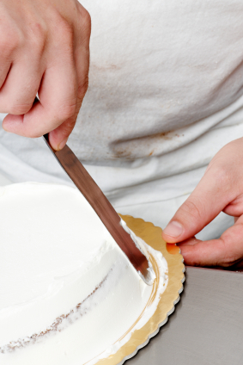
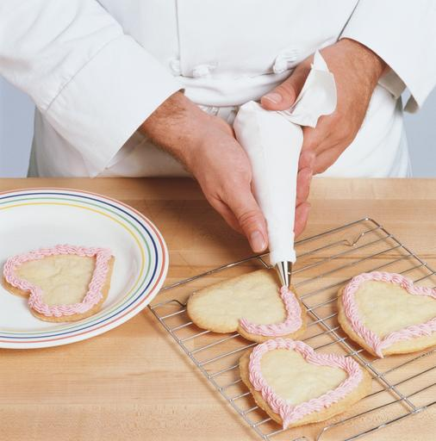
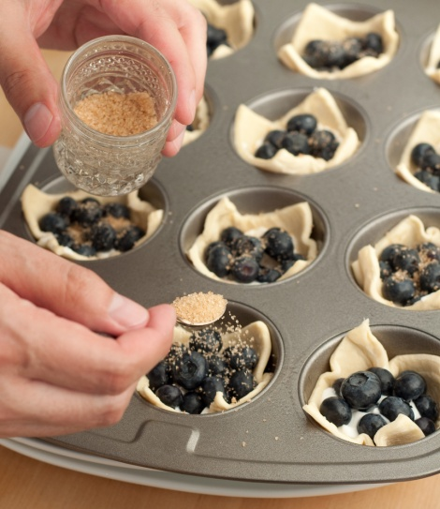
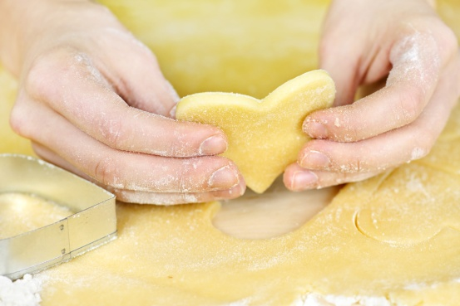
PREPARE AND PRODUCE CAKES AND PASTRIES
D1.HPA.CL4.08
Notes:
Trainer to introduce self and talk of personal bone fide to be able to teach this unit.
Give brief overview of your experience in patisserie and baking Industry.

Slide 2

Prepare and produce cakes and pastries
Assessment for this Unit may include:
Oral questions
Written questions
Work projects
Workplace observation of practical skills
Practical exercises
Formal report from employer/supervisor
Notes:
Trainer advises students that assessment for this Unit may take several forms all of which are aimed at verifying they have achieved competency for the Unit as required.
Trainer indicates to students the methods of assessment that will be applied to them for this Unit.

Slide 3

Prepare and produce cakes and pastries
This unit comprises five Elements
Prepare and bake cakes and fillings
Decorate and present/display cakes
Prepare and produce pastries and fillings
Decorate and present pastries
Store cakes and pastries
Notes:
Trainer advises students this Unit comprises five Elements, as listed on the slide explaining:
Each Element comprises a number of Performance Criteria which will be identified throughout the class and explained in detail
Students can obtain more detail from their Trainee Manual
The course presents advice and information but where their workplace requirements differ to what is presented, the workplace practices and standards must be observed.

Slide 4

Element 1: Prepare and bake cakes and fillings
Performance Criteria
Select required commodities according to recipe and production requirements
Prepare a variety of cakes to desired product characteristics
Produce a variety of cakes according to standard recipes and enterprise standards
Use appropriate equipment to prepare and bake cakes
Use correct techniques to produce cakes to enterprise standards
Bake cakes to enterprise requirements and standards
Select correct oven conditions for baking cakes
Notes:
Trainer to discuss:
Performance criteria relating to Element 1 - Prepare and bake cakes and fillings.

Slide 5
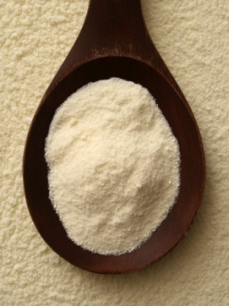
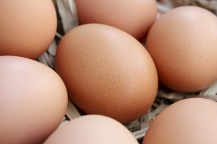
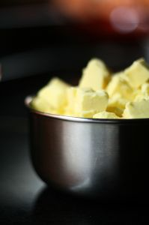
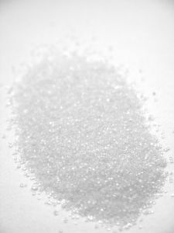
Element 1: Prepare and bake cakes and fillings
Select commodities
Flours
Sugars
Eggs
Milk
Cream
Gelatin
Flavourings and essences
Chocolate
Fats, oils, butter, margarines
Notes:
Trainer to discuss:
Give a brief synopsis of all the ingredients that may be used to produces cakes and pastries.

Slide 6
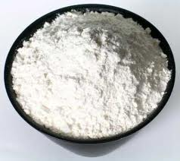
Element 1: Prepare and bake cakes and fillings
Select commodities
Flours:
Plain Flour
Self Raising Flour
Soft Cake Flour
Special Cake Flour
Notes:
Trainer to discuss:
There are many different types of flour on the market for making cakes
They are different to bread baking flours, they do not have the same gluten content
They are weaker in gluten
But of equal food value.
Each have a different role:
Plain Flour
General purpose flour that can be used across wide variety of goods.
Self Raising Flour
Plain flour that has an aerating agent (baking powder) added. 60g per kilo of flour is standard.
Variation can be used but the majority of premixed self raising flour is in this ratio.
Soft Cake Flour
Plain flour with low gluten content that has been finely milled to allow for more surface area to be able to absorb and hold liquid.
Special Cake Flour
Flour which has had the protein denatured by being chlorinated after milling
This has a bleaching effect and makes the flour appear whiter
The flour has been finely milled so it has smaller particle size. This finer size allows for greater ability to hold liquid
This Special flour works with special shortenings with emulsifiers that allow for all ingredients to be placed into the same bowl and will aerate during the mixing process
In contrast to sugar batter and flour batter methods.

Slide 7
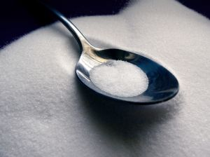
Element 1: Prepare and bake cakes and fillings
Select commodities
Sugars
Caster
Brown
A1 crystal
Glucose, powder and liquid
Icing
Fondant
Notes:
Trainer to discuss:
Different types of sugar in the market place:
Castor sugar is the best sugar to use in cake making because it dissolves best during the baking process and less evidence of un-dissolved grains after baking
Brown sugar is normal sucrose that has a portion of molasses added to the end product
Brown sugar comes in light brown and dark brown
A1 sugar crystal is the normal everyday sugar that most people know. It is not recommended for baking due to the grain size. Castor sugar is best because it has finer grain and will dissolve better in batters and pastry during the baking process.
Glucose
Comes in either liquid or powder form
Liquid form is used in baking and its main role beside sweetening is to help keep moisture in product
Liquid glucose is derived from starch. The starch is gelatinised and an acid is added and over time it converts to a sugar; glucose.
Icing sugar
Finer grind of sugar, very small particles.
Fondant
Fondant is a sugar solution that has been boiled to 114-117C and then cooled and while cooling it is agitated to form a white mass
Before applying it needs to be tempered.

Slide 8
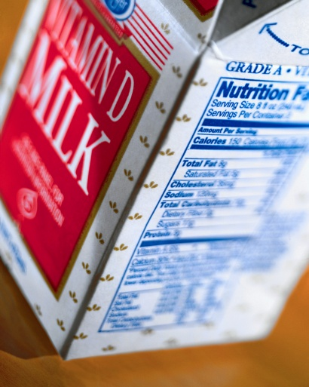

Element 1: Prepare and bake cakes and fillings
Select commodities
Eggs
Dairy products and substitutes
Milk
Cream
Fats, oils, butter, margarines
Notes:
Trainer to discuss:
Products in the marketplace:
Eggs
Are available in many forms
Fresh, frozen, powdered
Milk comes in several forms, fresh, powdered
Cream comes both fresh and imitation
Fresh need refrigeration and is hard to control in hot humid climates
Fats, oils, butter, margarines
All are fats and come in many forms
Practitioner needs to choose what is best adapted to the needs of the product.

Slide 9
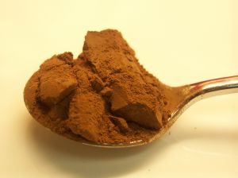
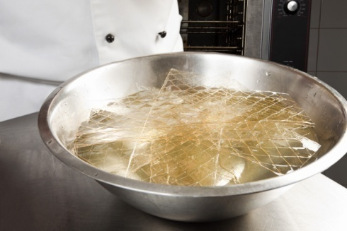
Element 1: Prepare and bake cakes and fillings
Select commodities
Chocolate
Cocoa powder
Nuts
Gelatin
Flavourings and essences
Notes:
Trainer to discuss:
Products in the marketplace:
Chocolate
Cocoa powder
Chocolate coverture and bakers chocolate can be used
Cocoa powder is the powder flavour of the cocoa pod
Nuts
Ground varieties are used in bakery products, sliced and chopped may be roasted and used for decoration
Gelatin and agar agar a just two gelling agents that can be used
Flavourings and essences
Spices and liquid flavourings and colourings are also used, varieties are endless.

Slide 10
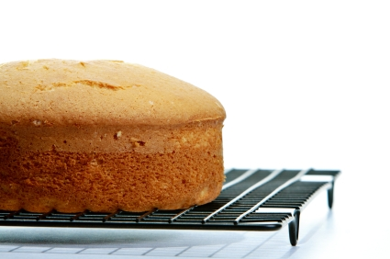
Element 1: Prepare and bake cakes and fillings
Prepare a variety of cakes:
Sponge
Pound cakes
High ratio cakes
Fudge style cakes
Special dietary needs
Honey and spice cakes
Fruit cakes, Light
Fruit cakes, Dark
Notes:
Trainer to discuss:
Each of the following in the subsequent slides:
Pound cakes
High ratio cakes
Fudge style cakes
Special dietary needs
Honey and spice cakes
Fruit cakes, Light
Fruit cakes, Dark.

Slide 11
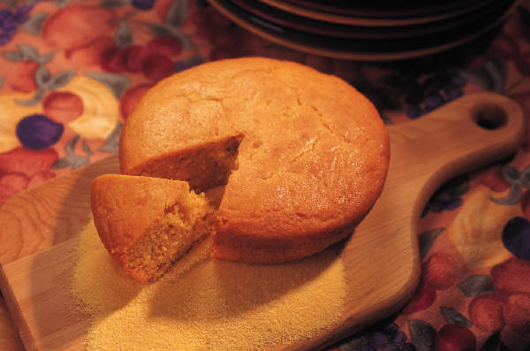
Element 1: Prepare and bake cakes and fillings
Prepare a variety of cakes
Sponge:
Genoise
Sponge drops
Sponge sheets
Emulsified sponge
Notes:
Trainer to discuss:
What are sponge cakes and how to prepare them:
Genoise
Sponge drops
Sponge sheets
Emulsified sponge.

Slide 12
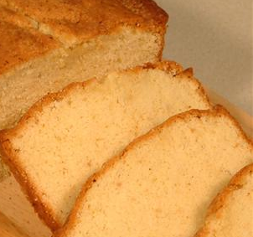
Element 1: Prepare and bake cakes and fillings
Prepare a variety of cakes
Pound cakes:
Madeira cakes
Butter cake
Pandowdy cakes
Carrot cake
Vegetable oil based cakes
Notes:
Trainer to discuss:
The different varieties of pound cakes and their preparation:
Madeira cakes
Butter cake
Pandowdy cakes
Carrot cake
Vegetable oil based cakes.

Slide 13
Element 1: Prepare and bake cakes and fillings
Prepare a variety of cakes
High ratio cakes
Special shortening and emulsifiers used to produce fine texture and gentle eating products
Special flours of finer starch grain
Flour has protein de-natured
Holds more water
Formula contains more sugar
Notes:
Trainer to discuss:
What are High ratio cakes and their preparation method:
Special shortening and emulsifiers used to produce fine texture and gentle eating products
Special flours of finer starch grain
Flour has protein de-natured
Holds more water
Formula contains more sugar.

Slide 14
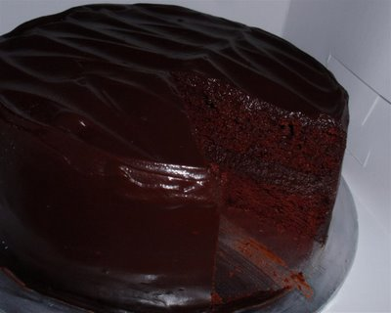
Element 1: Prepare and bake cakes and fillings
Prepare a variety of cakes
Fudge style cakes:
Caramel fudge
Banana
Chocolate fudge
Notes:
Trainer to discuss:
What are Fudge style cakes, their varieties and preparation methods:
Caramel fudge
Banana
Chocolate fudge.

Slide 15


Element 1: Prepare and bake cakes and fillings
Prepare a variety of cakes
Special dietary needs:
Gluten free
Milk free
Egg free
Soy free
Low fat
Gluten-free
Soy-free
Notes:
Trainer to discuss:
What are the special dietary needs in preparing cakes:
Gluten free
Milk free
Egg free
Soy free
Low fat.

Slide 16
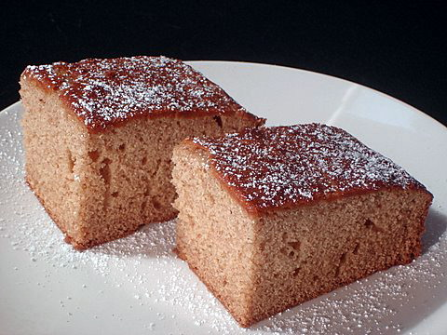
Element 1: Prepare and bake cakes and fillings
Prepare a variety of cakes
Honey and spice cakes
Ginger breads
Honey cakes
Notes:
Trainer to discuss:
Other varieties of cakes such as:
Honey and spice cakes
Ginger breads
Honey cakes.

Slide 17
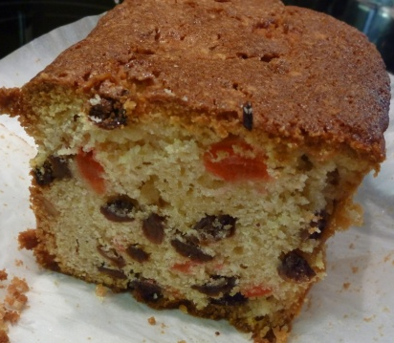
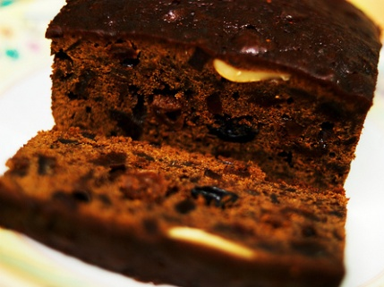
Element 1: Prepare and bake cakes and fillings
Prepare a variety of cakes
Fruit cakes, Light:
Dundee
Simnel
Fruit cakes, dark:
Heavily fruited and spiced
Very heavy and dense
Notes:
Trainer to discuss:
The different types and characteristics of fruit cakes:
Fruit cakes - light
Fruit cakes – dark.

Slide 18
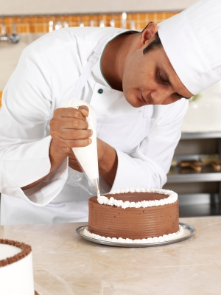
Element 1: Prepare and bake cakes and fillings
Prepare a variety of cakes
To be able to produce a variety of cakes pastry cooks (patissiers) need to be able to be adaptive:
Styles change
Traditions evolve
History gets lost
Seasonality fades
Notes:
Trainer to discuss:
The importance of being adaptive in order to produce a wide variety of cakes due to the following reasons:
Styles change
Traditions evolve
History gets lost
Seasonality fades.

Slide 19
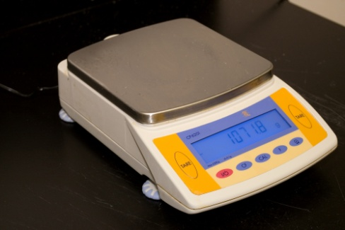
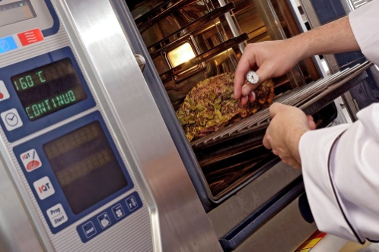
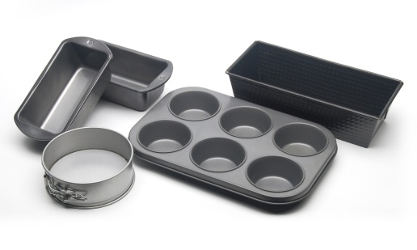
Element 1: Prepare and bake cakes and fillings
Use appropriate equipment
Mixers
Ovens
Scales
Moulds and forms
Baking trays and racks
Notes:
Trainer to discuss:
The appropriate equipment to prepare and bake cakes and fillings.

Slide 20
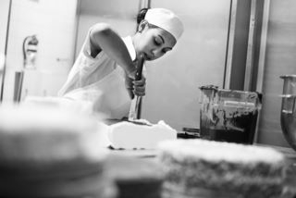
Element 1: Prepare and bake cakes and fillings
Bake to enterprise standards:
Bakery
Patisserie
Wholesale
5 Star Hotel
Budget market place
Notes:
Trainer to discuss:
The importance of baking to enterprise standards.

Slide 21

Element 1: Prepare and bake cakes and fillings
Standards and quality will change as enterprise changes
Standards are kept by pastry cooks working to high standards and producing consistent quality no matter where they work
Quality is relative to how much the customer is prepared to pay
Notes:
Trainer to discuss:
Standards and quality will change as enterprise changes
Standards are kept by pastry cooks working to high standards and producing consistent quality no matter where they work
Quality is relative to how much the customer is prepared to pay.

Slide 22

Element 2: Decorate and present/display cakes
Performance Criteria
Prepare a variety of fillings and coatings, icings, glazes and decorations for cakes
Decorate cakes using fillings, coatings, icings and decorations according to standard recipes and or enterprise standards and or customer requests
Present and display cakes to enterprise standards using appropriate service equipment
Notes:
Trainer to discuss:
Performance criteria relating to Element 2 - Decorate and present/display cakes.

Slide 23
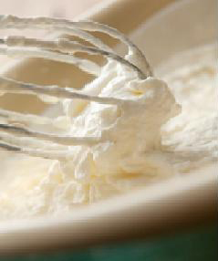

Element 2: Decorate and present/display cakes
Prepare a variety of fillings, icings decorations for cakes:
Fillings
Creams, fresh
Creams, butter creams
Creams, imitation
Creams, others
Notes:
Trainer to discuss:
The different types of fillings for cakes.

Slide 24
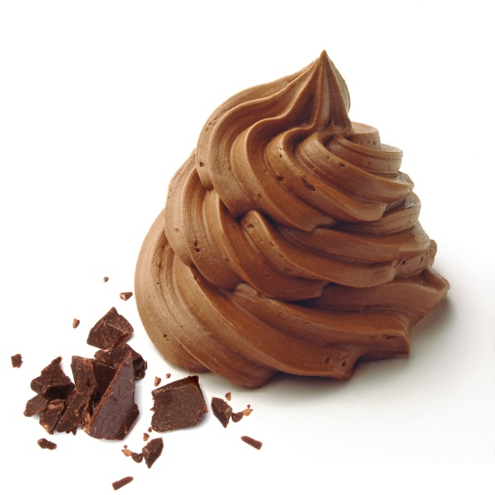
Element 2: Decorate and present/display cakes
Prepare a variety of fillings icings decorations for cakes:
Icing and glaze
Fudge
Fondant
Plastic
Ganache
Notes:
Trainer to discuss and provide examples:
The different icings and decorations for cakes.

Slide 25
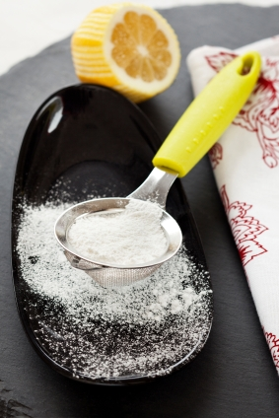
Element 2: Decorate and present/display cakes
Decoration to enterprise standard:
Icing sugar
Fondant
Apricot jam
Roasted nuts
Glaze and gel
Notes:
Trainer to discuss:
Decoration is the final part of the production of any product
Some need no further additions
Some are added before the baking begins.
Icing Sugar
Sprinkled over product after it has come out of the oven
If sprinkled while product is still hot icing sugar has a tendency to bond to the product.
Con: when people go to eat the product and breath in it can cause people to cough,
Customers have to lick fingers after eating.
Fondant
Fondant is cooked sugar. It needs to be tempered so it will maintain the gloss or shine
Used in Australia and Europe extensively. Limited use in Asia due to availability and humid conditions.
Apricot jam
Boiling Apricot jam is applied to baked Danish and sweet yeast goods as a glaze. It must be applied to hot product so it will dry to there touch when cool
Adds flavour and slows moisture migration from fondant icing and pastry.
Roasted Nuts
Sliced and roasted are commonly used to decorate Danish style pastries after baking
Can be expensive to use, use sparingly.
Glazes and gels
These are available in the commercial market. Seaweed based gels are used to apply a shine to finished product
Used mainly on Danish pastries with crème patisserie and fruit fillings
Protects form dehydration, exposure to the air.

Slide 26
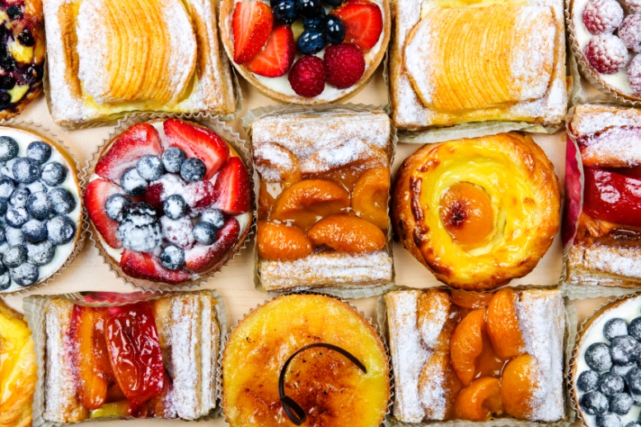
Element 2: Decorate and present/display cakes
Present and display to enterprise standards:
Bakery
Trays
Platters
Cellophane bags
Boxes
Doyleys
Labels
Notes:
Trainer to discuss:
Trays
After taking from oven product is placed onto cooling wires, decorated and then placed on trays or platters.
Doyleys
Some larger product might be placed on to a doyley and displayed individually. The role of the doyley is to have a barrier under product and protect from surface contamination.
Boxes
Product might be placed into boxes and displayed for sale, lots of 6 or 12
Some boxes might have see through lids.
Cellophane bags
Bags are clear, see through. Product is placed inside bags to protect from outside contamination and to slow the staling process. Staling is caused by air passing through product and removing moisture. Or moisture evaporates from surface.
Labels
Packaged products will have label showing ingredients, name of manufacture and other legal requirements
They make good advertising.

Slide 27

Element 3: Prepare and produce pastries and fillings
Performance Criteria
Select required commodities according to recipe and production requirements
Prepare a variety of pastries
Produce a variety of pastries according to standard recipes and enterprise standards
Use appropriate equipment to prepare and bake pastries
Use correct techniques to produce pastries to enterprise standards
Bake pastries to enterprise requirements and standards
Select correct oven conditions for baking pastries
Notes:
Trainer to discuss:
Performance criteria relating to Element 3 - Prepare and produce pastries and fillings.

Slide 28
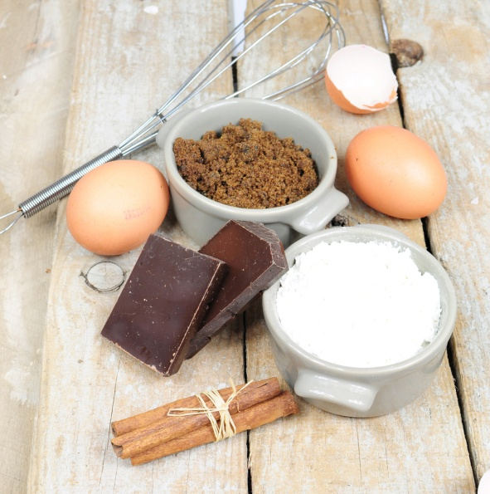
Element 3: Prepare and produce pastries and fillings
Select required commodities:
Flours
Sugars
Eggs
Milk
Cream
Gelatin
Flavourings and essences
Chocolate
Fats, oils, butter, margarines
Notes:
Trainer to discuss:
The selection of required commodities in the preparation and production of pastries and fillings in the subsequent slides.

Slide 29
Element 3: Prepare and produce pastries and fillings
Select required commodities:
Flours
Strong flour Flour
Self Raising Flour
Pastry Flour
High Ratio Flour
Notes:
Trainer to discuss:
There are many different types of flour on the market
Each have a different role
Gluten content is different in each.

Slide 30
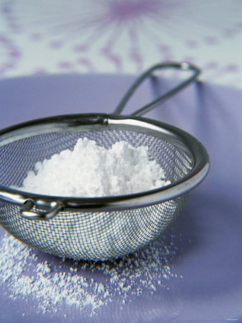
Element 3: Prepare and produce pastries and fillings
Select required commodities:
Sugars
Caster
Brown
A1 crystal
Glucose, powder and liquid
Icing
Fondant
Notes:
Trainer to discuss:
Different types of sugar in the market place:
Castor sugar is the best sugar to use in cake making because it dissolves best during the baking process and less evidence of un-dissolved grains after baking
Brown sugar is normal sucrose that has a portion of molasses added to the end product
Brown sugar comes in light brown and dark brown
A1 sugar crystal is the normal everyday sugar that most people know. It is not recommended for baking due to the grain size. Castor sugar is best because it has finer grain and will dissolve better in batters and pastry during the baking process.
Glucose
Comes in either liquid or powder form
Liquid form is used in baking and its main role beside sweetening is to help keep moisture in product
Liquid glucose is derived from starch. The starch is gelatinised and an acid is added and over time it converts to a sugar; glucose.
Icing sugar
Finer grind of sugar, very small particles.
Fondant
Fondant is a sugar solution that has been boiled to 114-117C and then cooled and while cooling it is agitated to form a white mass
Before applying it needs to be tempered.

Slide 31

Element 3: Prepare and produce pastries and fillings
Select required commodities:
Eggs
Dairy products and substitutes
Milk
Cream
Fats, oils, butter, margarines
Notes:
Trainer to discuss:
Products in the marketplace:
Eggs
Are available in many forms
Fresh, frozen, powdered
Milk comes in several forms, fresh, powdered
Cream comes both fresh and imitation
Fresh need refrigeration and is hard to control in hot humid climates
Fats, oils, butter, margarines
All are fats and come in many forms
Practitioner needs to choose what is best adapted to the needs of the product.

Slide 32
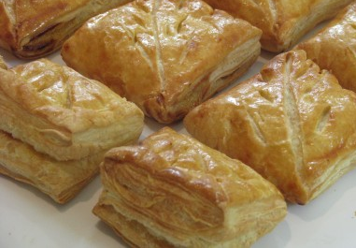
Element 3: Prepare and produce pastries and fillings
Prepare variety of pastries:
Puff pastry
Mille fueille
Vol au vents
Chausson aux pommes
Notes:
Trainer to discuss:
Giving examples of items made from each of these pastry varieties.

Slide 33
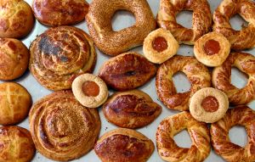
Element 3: Prepare and produce pastries and fillings
Prepare variety of pastries:
Short pastry
Quiche
Savoury rolls
Pie bases
Crusts
Notes:
Trainer to discuss:
Giving examples of items made from each of these pastry varieties.

Slide 34
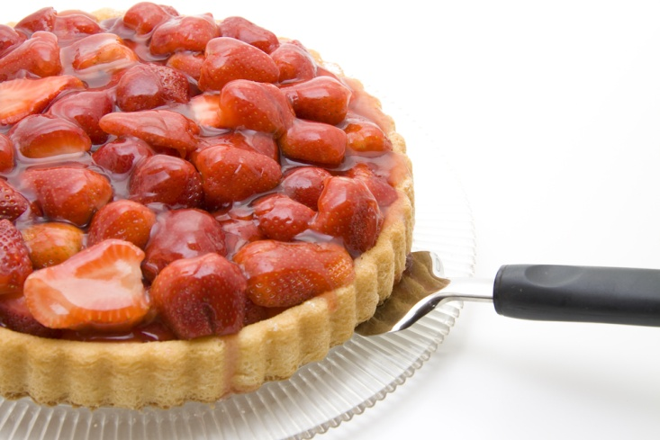
Element 3: Prepare and produce pastries and fillings
Prepare variety of pastries:
Sweet short pastry
Fruit pies
Sweet rolls
Pie bases
Shortbread biscuits
Notes:
Trainer to discuss:
Giving examples of items made from each of these pastry varieties.

Slide 35
Element 4: Decorate and present pastries
Performance Criteria
Prepare a variety of fillings, coatings, icings, glazes and decorations for pastries
Decorate pastries using coating, icing and decorations according to standard recipes and or enterprise standards and or customer requests
Present and display pastries to enterprise standards using appropriate service equipment
Notes:
Trainer to discuss:
Performance criteria relating to Element 4 - Decorate and present pastries.

Slide 36
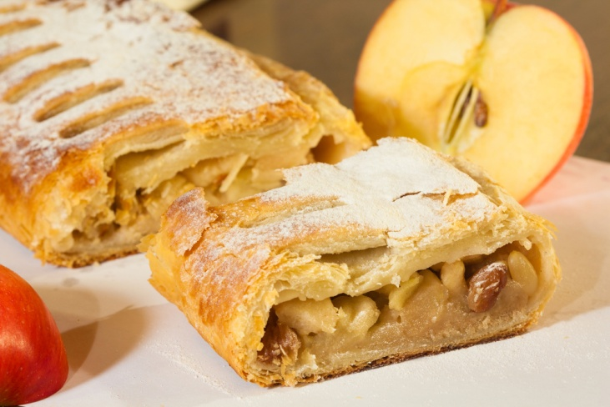
Element 4: Decorate and present pastries
Prepare variety of fillings and glazes:
Cream
Fruit fillings
Savoury meat fillings
Savoury vegetable fillings
Notes:
Trainer to discuss:
Examples of the use of these fillings in producing various items/dishes.

Slide 37
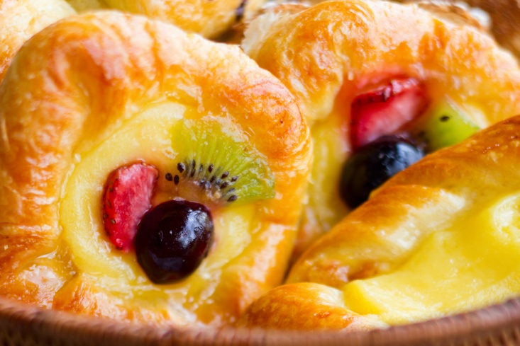
Element 4: Decorate and present pastries
Decorate pastries to enterprise standards:
Everyday presentation
Celebratory occasion
Notes:
Trainer to discuss:
Examples of everyday presentation, and examples of a variety of celebratory occasions.

Slide 38
Element 4: Decorate and present pastries
Present/display to enterprise standards:
Formal
Casual
In house
Take home
Notes:
Trainer to discuss:
The decoration and presentation of pastries needs to take into account the setting and the use of the pastry items.
Ask the class to provide examples for each of the following:
Formal
Casual
In house
Take home.

Slide 39

Element 5: Store cakes and pastries
Performance Criteria
Store at correct temperature and conditions of storage
Maintain maximum eating quality, appearance and freshness
Notes:
Trainer to discuss:
Performance criteria relating to Element 5 - Store cakes and pastries.

Slide 40
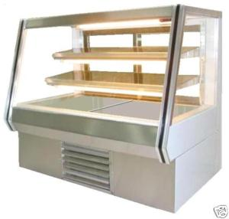
Element 5: Store cakes and pastries
Store at correct temperatures:
Room Temperature
Protect from outside contamination
Date of production
Labelling
Notes:
Trainer to discuss:
The important aspects of each of these:
Room Temperature – Discuss variations of room temperature in various climates, particular emphasis on heat and humidity in Southeast Asian nations
Protect from outside contamination – Discuss various forms of contamination including chemical, biological and vermin/pests
Date of production – Discuss the importance of absolute freshness in pastry products
Labelling – As with all fresh food products, complete and correct labelling is vital.

Slide 41
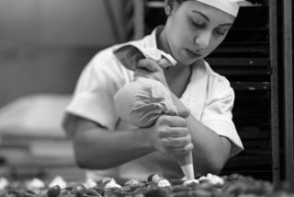
Element 5: Store cakes and pastries
Maintain maximum eating quality:
Produce as needed
Make in small batches
Protect from contamination
Notes:
Trainer to discuss:
Produce as needed
Produce only what is required as the product will stale quickly and eating quality will diminish
Make in small batches
Smaller batches will keep quality at maximum
Protect from contamination
Keep covered to protect from outside contamination and slow staling process.

